Slide 1

Emerging Technologies and Transit
Hannah DeBruin
Weekly Meeting: Transit Data Subgroup
9/21/22

Slide 2
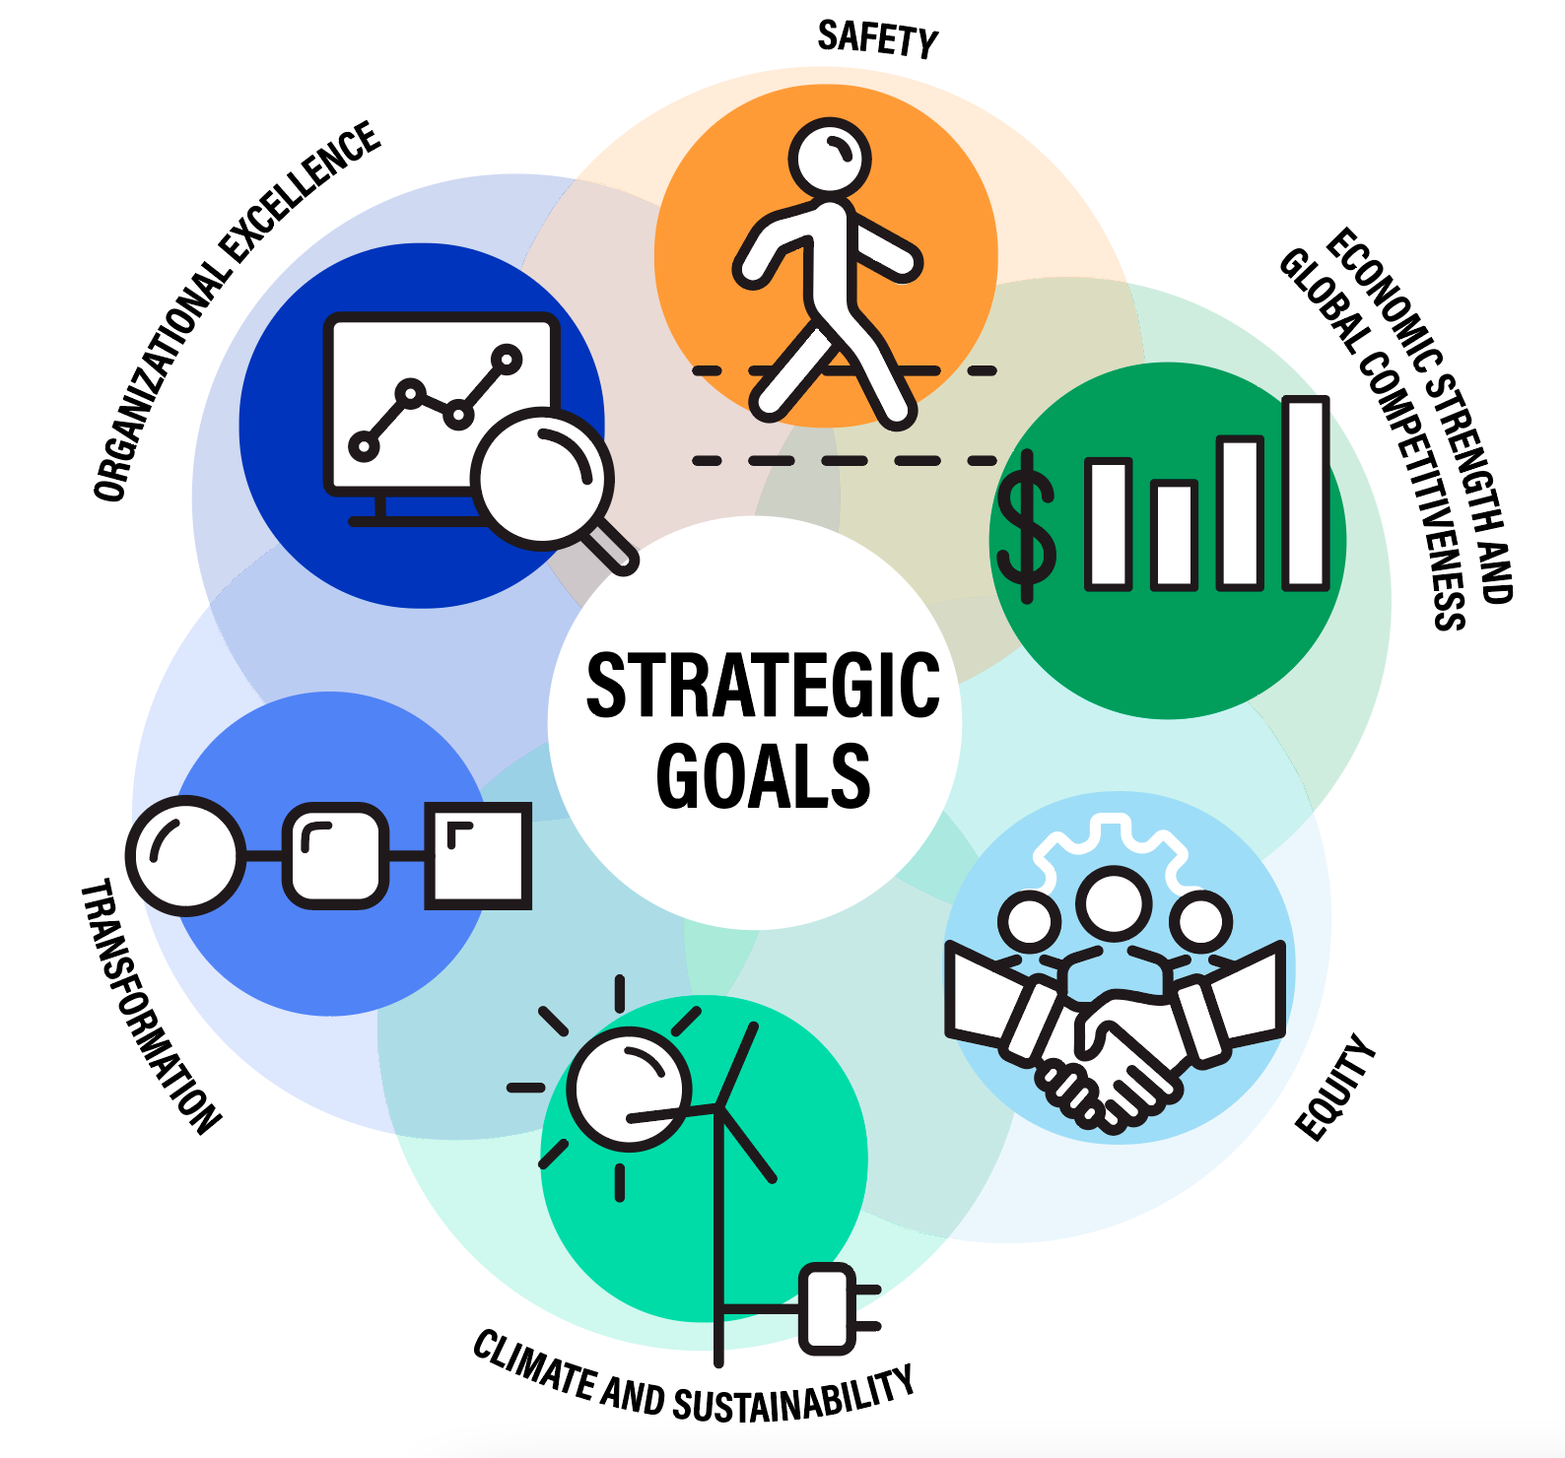
Overview of Considerations
Interactions between transit and new tech:
Ridership (mode choice)
Efficiency of transit operations (optimization, congestion of road network)
Funding (could tax revenue be generated from new tech?)
Land development patterns (could this technology contribute to sprawl?)
Network Positives/Concerns:
Comfort/safety
Environmental externalities (air quality, noise pollution, public health)
Serving mobility needs (peak, off-peak commutes, discretionary travel)
Operating costs (less drivers, cheaper fuel, etc)
DOT Strategic Goals
Weekly Meeting (9/21/2022)
Hannah DeBruin

Slide 3
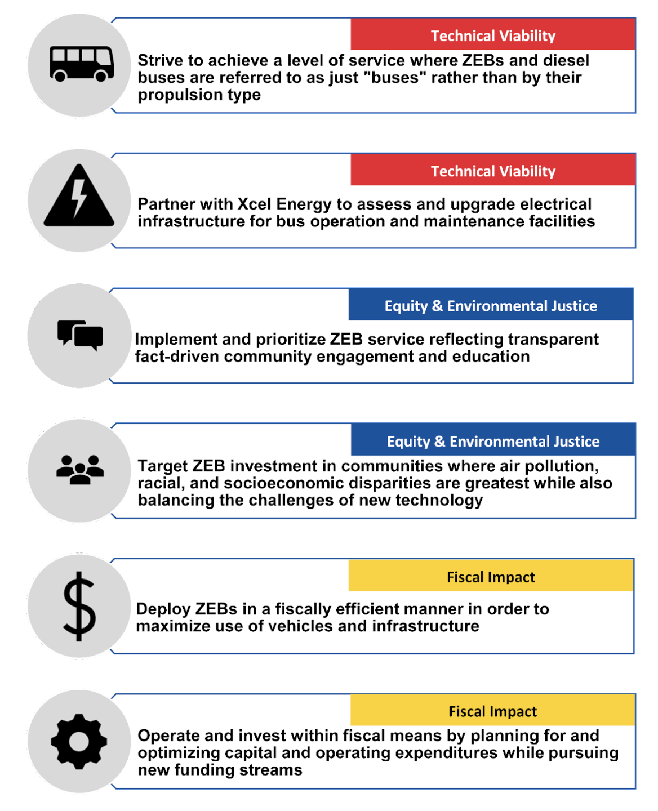
Electrification Complimenting Transit (Opportunities)
Fleet electrification – feasibility? Benefits? State of practice?? Policy incentives?
Vehicle range, charging, and route planning
Fleet replacement timeline planning (Metro Transit released a zero-emissions bus transition plan in February 2022, see figure to the right)
Generally lower operating costs
Less local noise pollution, air pollution contributed from transit (which contributes a small amount anyway)
Weekly Meeting (9/21/2022)
Hannah DeBruin

Slide 4
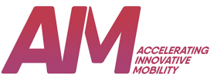
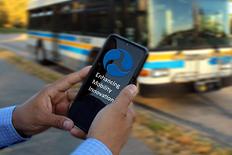
FTA Research Interests
Accelerating Innovative Mobility (AIM)
“The primary objectives of AIM are to:
Foster innovative transit technologies, practices and solutions that advance the state of practice for public transportation in the U.S.
Leverage private sector investments in mobility for the benefit of transit
Ensure innovative technologies and practices permit interoperability across systems and modes
Share results of innovative mobility solutions with the transit industry and stakeholders”
Integrated Mobility Innovation
“The primary objectives of IMI are to:
Enhance transit industry preparedness for IMI
Assist the transit industry to develop the ability to integrate IMI practices with existing public transit service
Validate the technical and institutional feasibility of IMI business models, and document IMI best practices that may emerge from the demonstrations
Measure the impacts of IMI on travelers and transportation systems
Examine relevant public sector and Federal requirements, regulations, and policies that may support or hamper the public transit sector’s adoption of IMI”
https://www.youtube.com/watch?v=GBuOhT2eyRc
Weekly Meeting (9/21/2022)
Hannah DeBruin

Slide 5
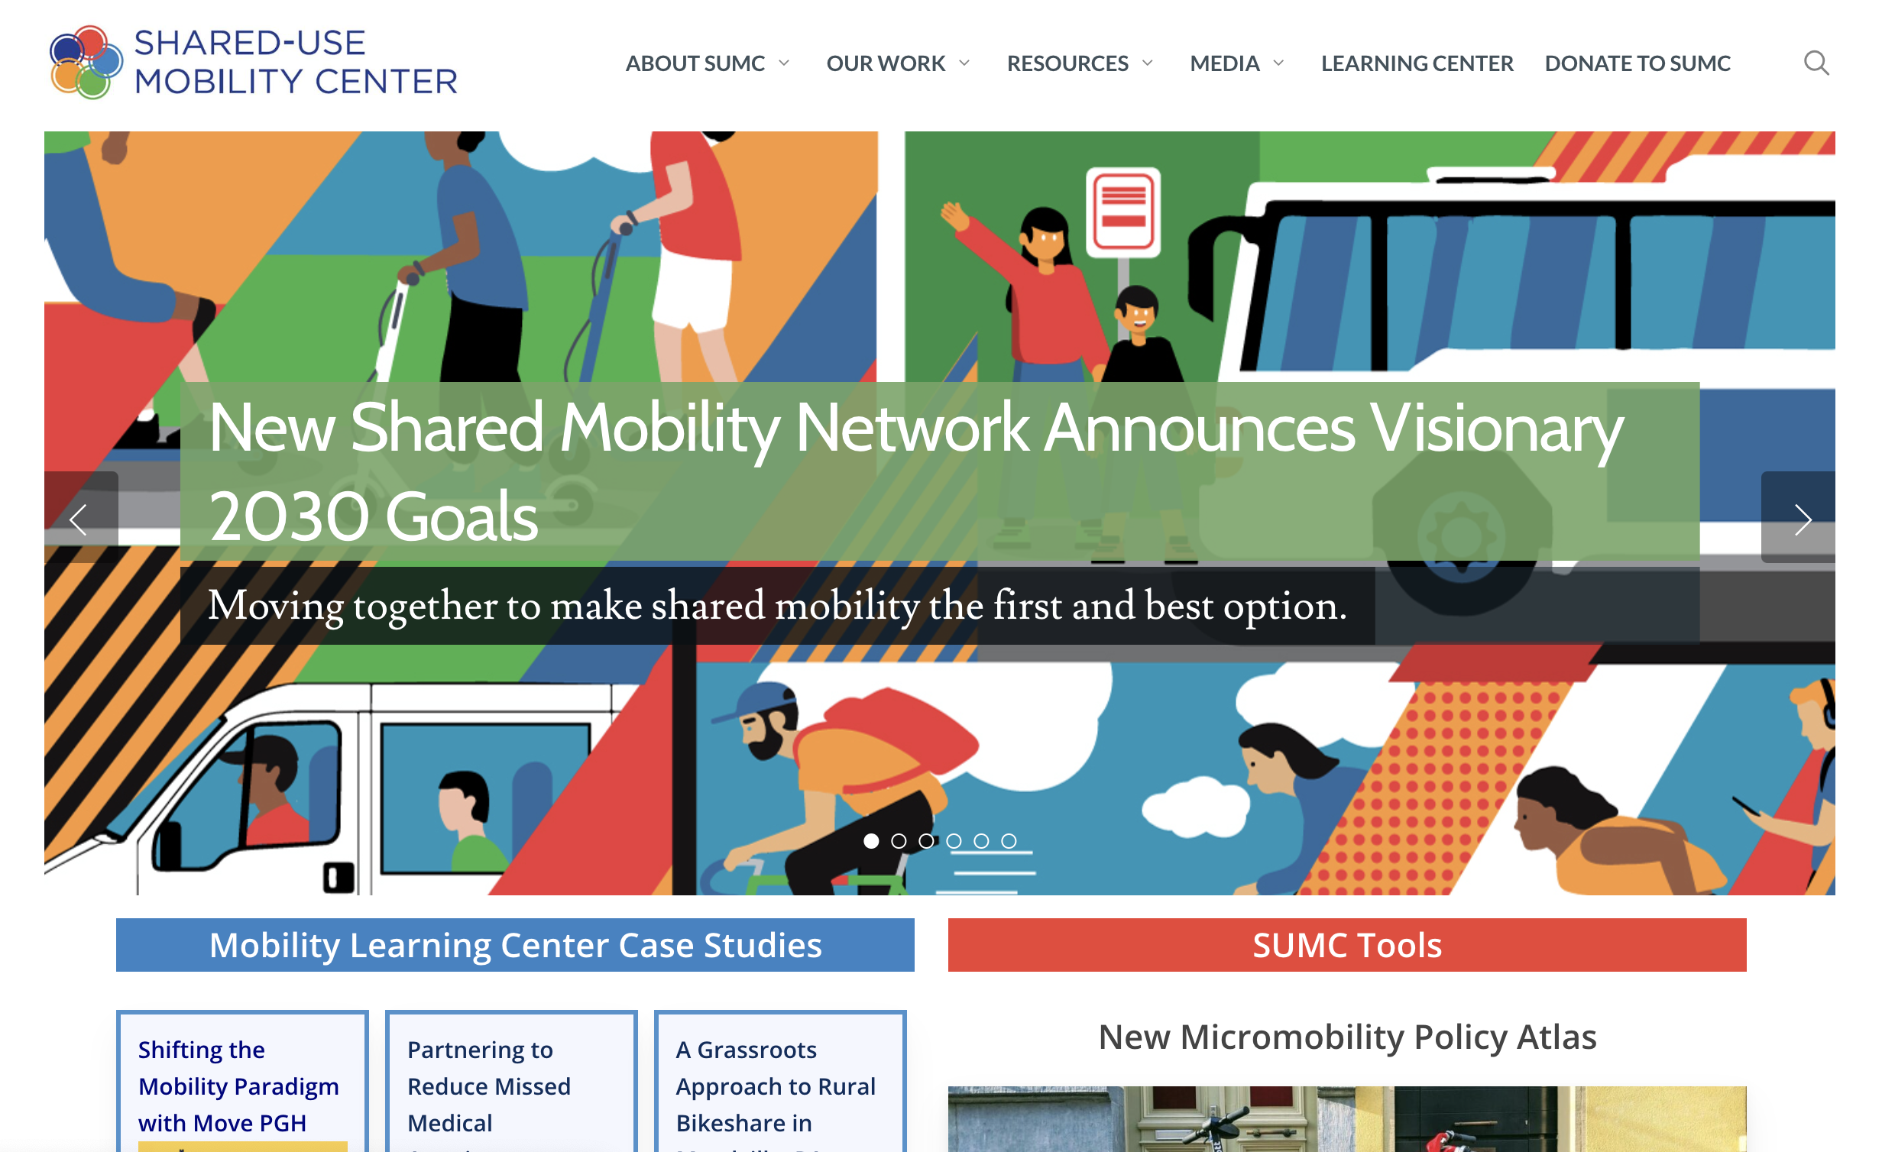
Shared Use Mobility Center
Hub for guidance, case studies, and educational modules about:
Autonomous transit
Mobility on demand
Micromobility
Multimodal integrated payment
Weekly Meeting (9/21/2022)
Hannah DeBruin

Slide 6
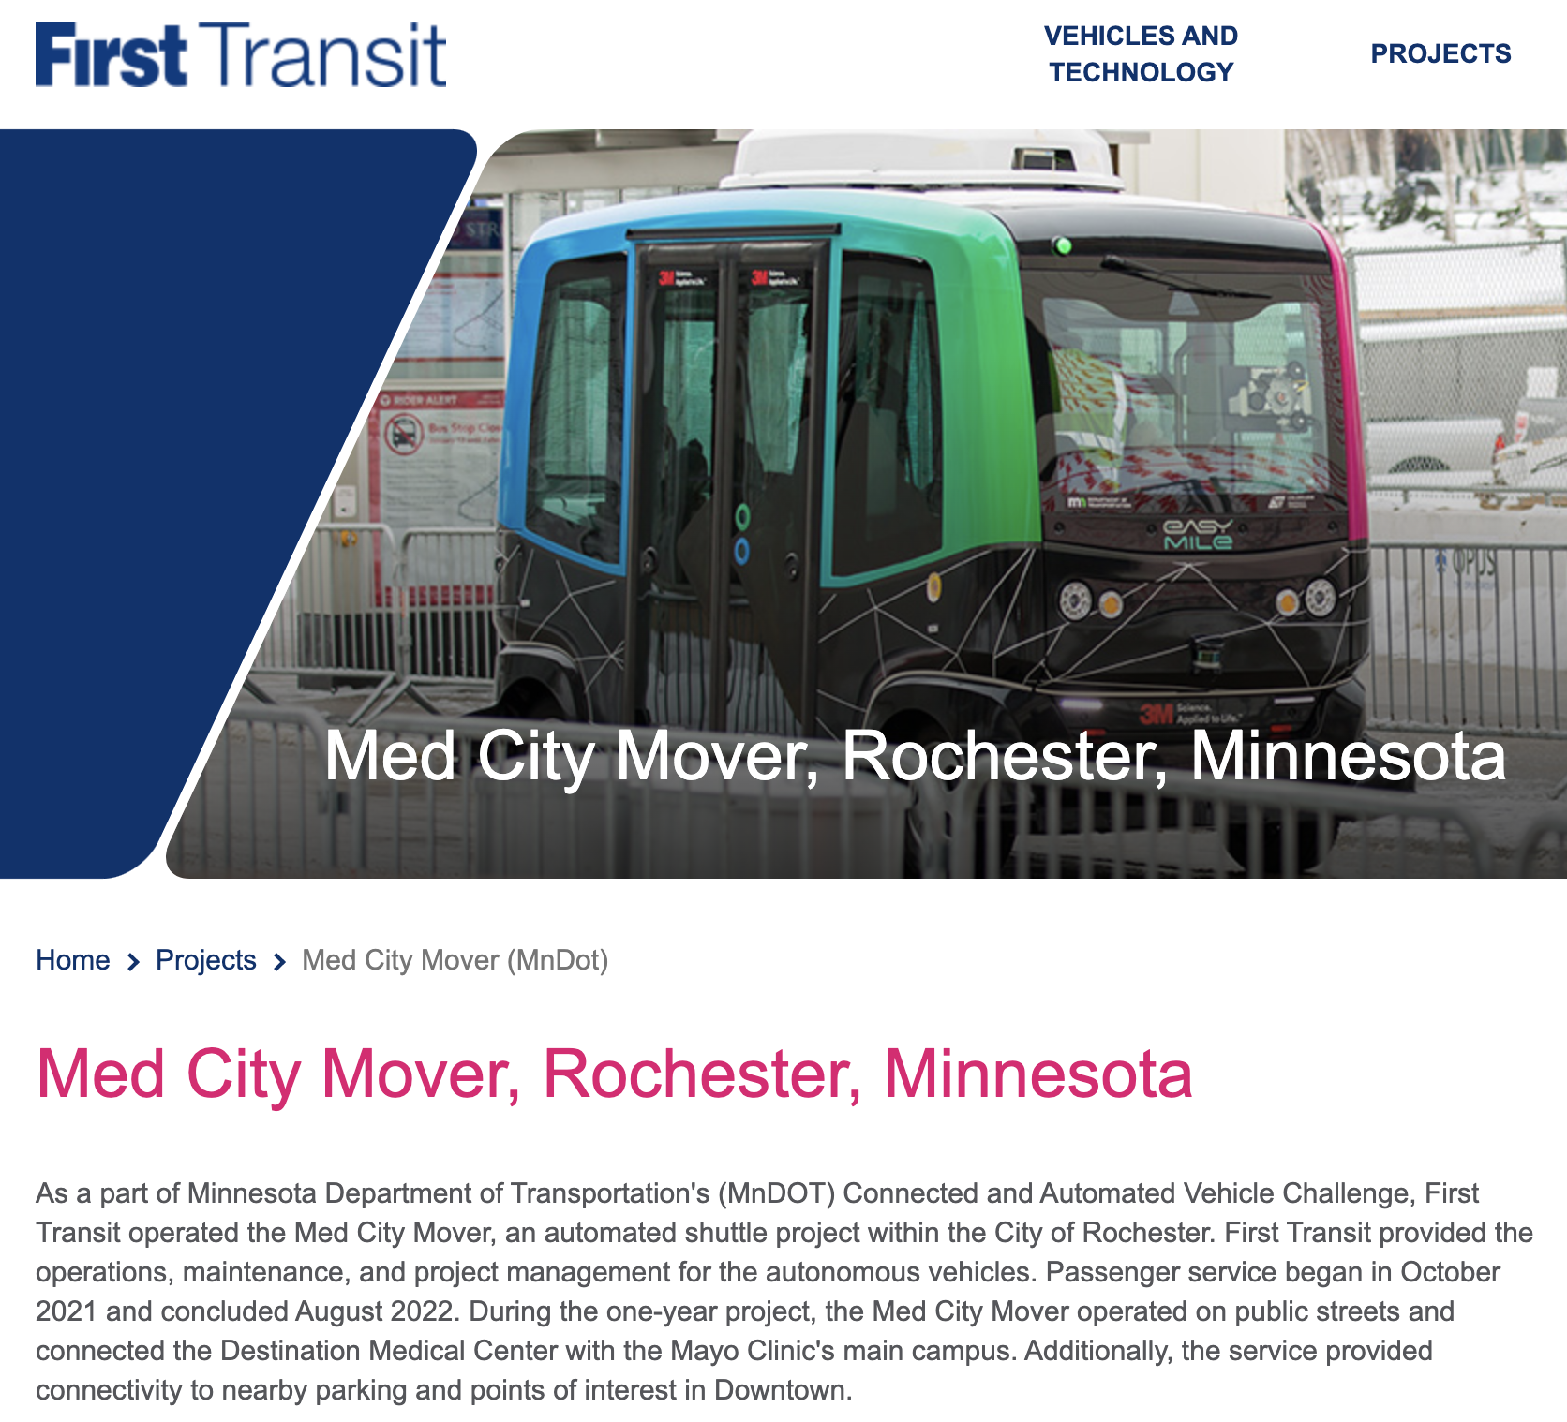
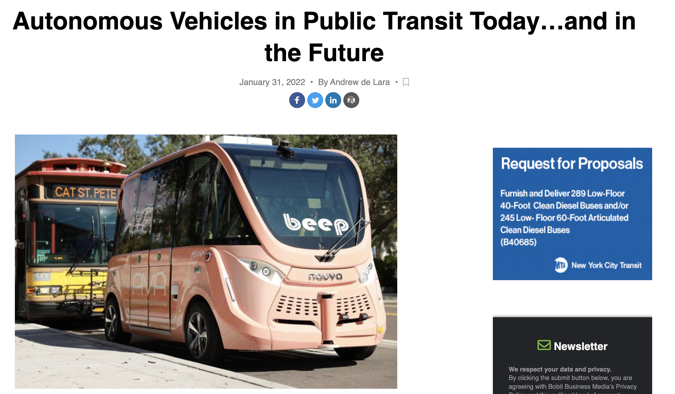
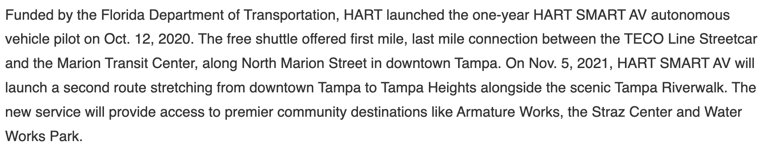
Autonomous Transit Vehicles
Three Transit Authorities in Florida – AV Shuttles
https://www.metro-magazine.com/10154922/autonomous-vehicles-in-public-transit-today-and-in-the-future
https://www.firstsav.com/projects/mndot-rochester-minnesota
Weekly Meeting (9/21/2022)
Hannah DeBruin

Slide 7
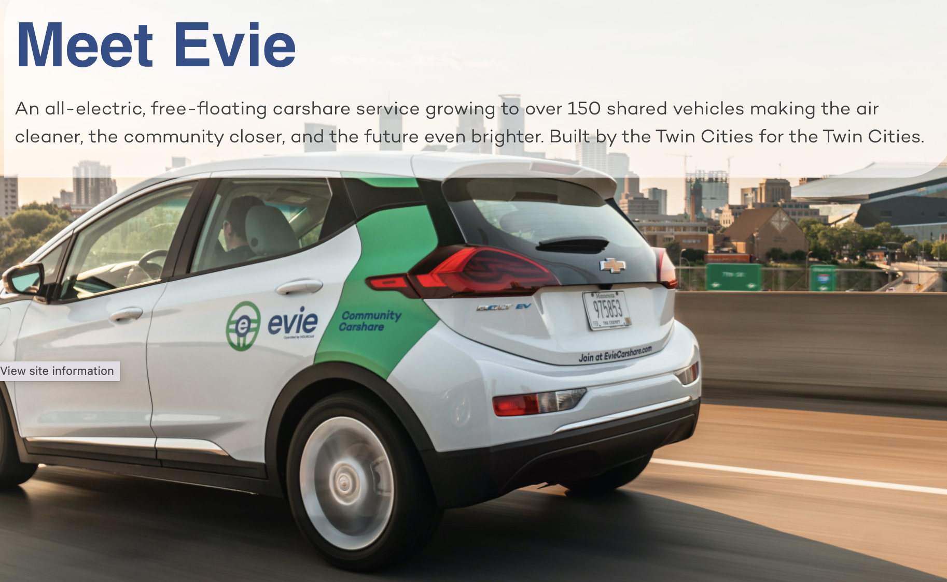
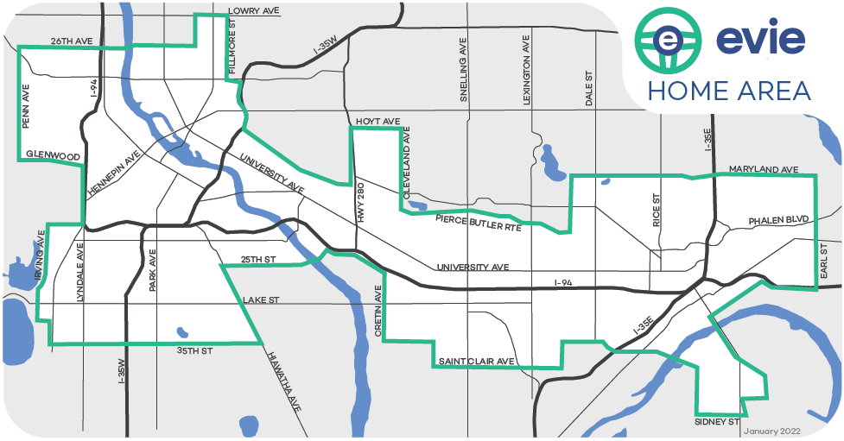
Electric Vehicle Carsharing in MN!
https://eviecarshare.com/
Weekly Meeting (9/21/2022)
Hannah DeBruin

